Slide 1
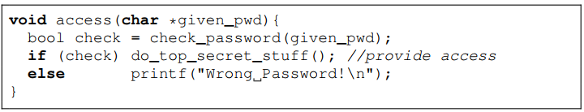
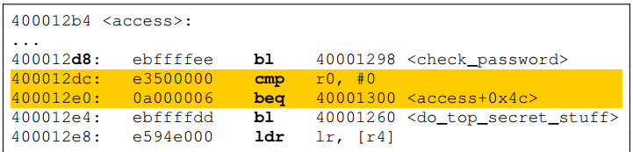
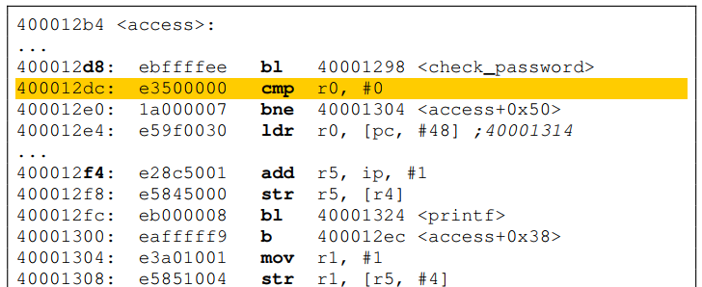
Updates
Oral proposal submitted to the committee
Compiler-based software hardening
Working on deriving compiler-friendly parameters from layout-level laser modeling
Investigations on GCC compiler plug-in, hardening rules, etc. Found 2 hardening database
Implemented a simple hardening technique in the form of GCC plug-in
Compile
Harden
What happened?
Faults modifying/bypassing the conditional jump will now directly lead to a password-checking failure

